Slide 1
Dashboard

Slide 2
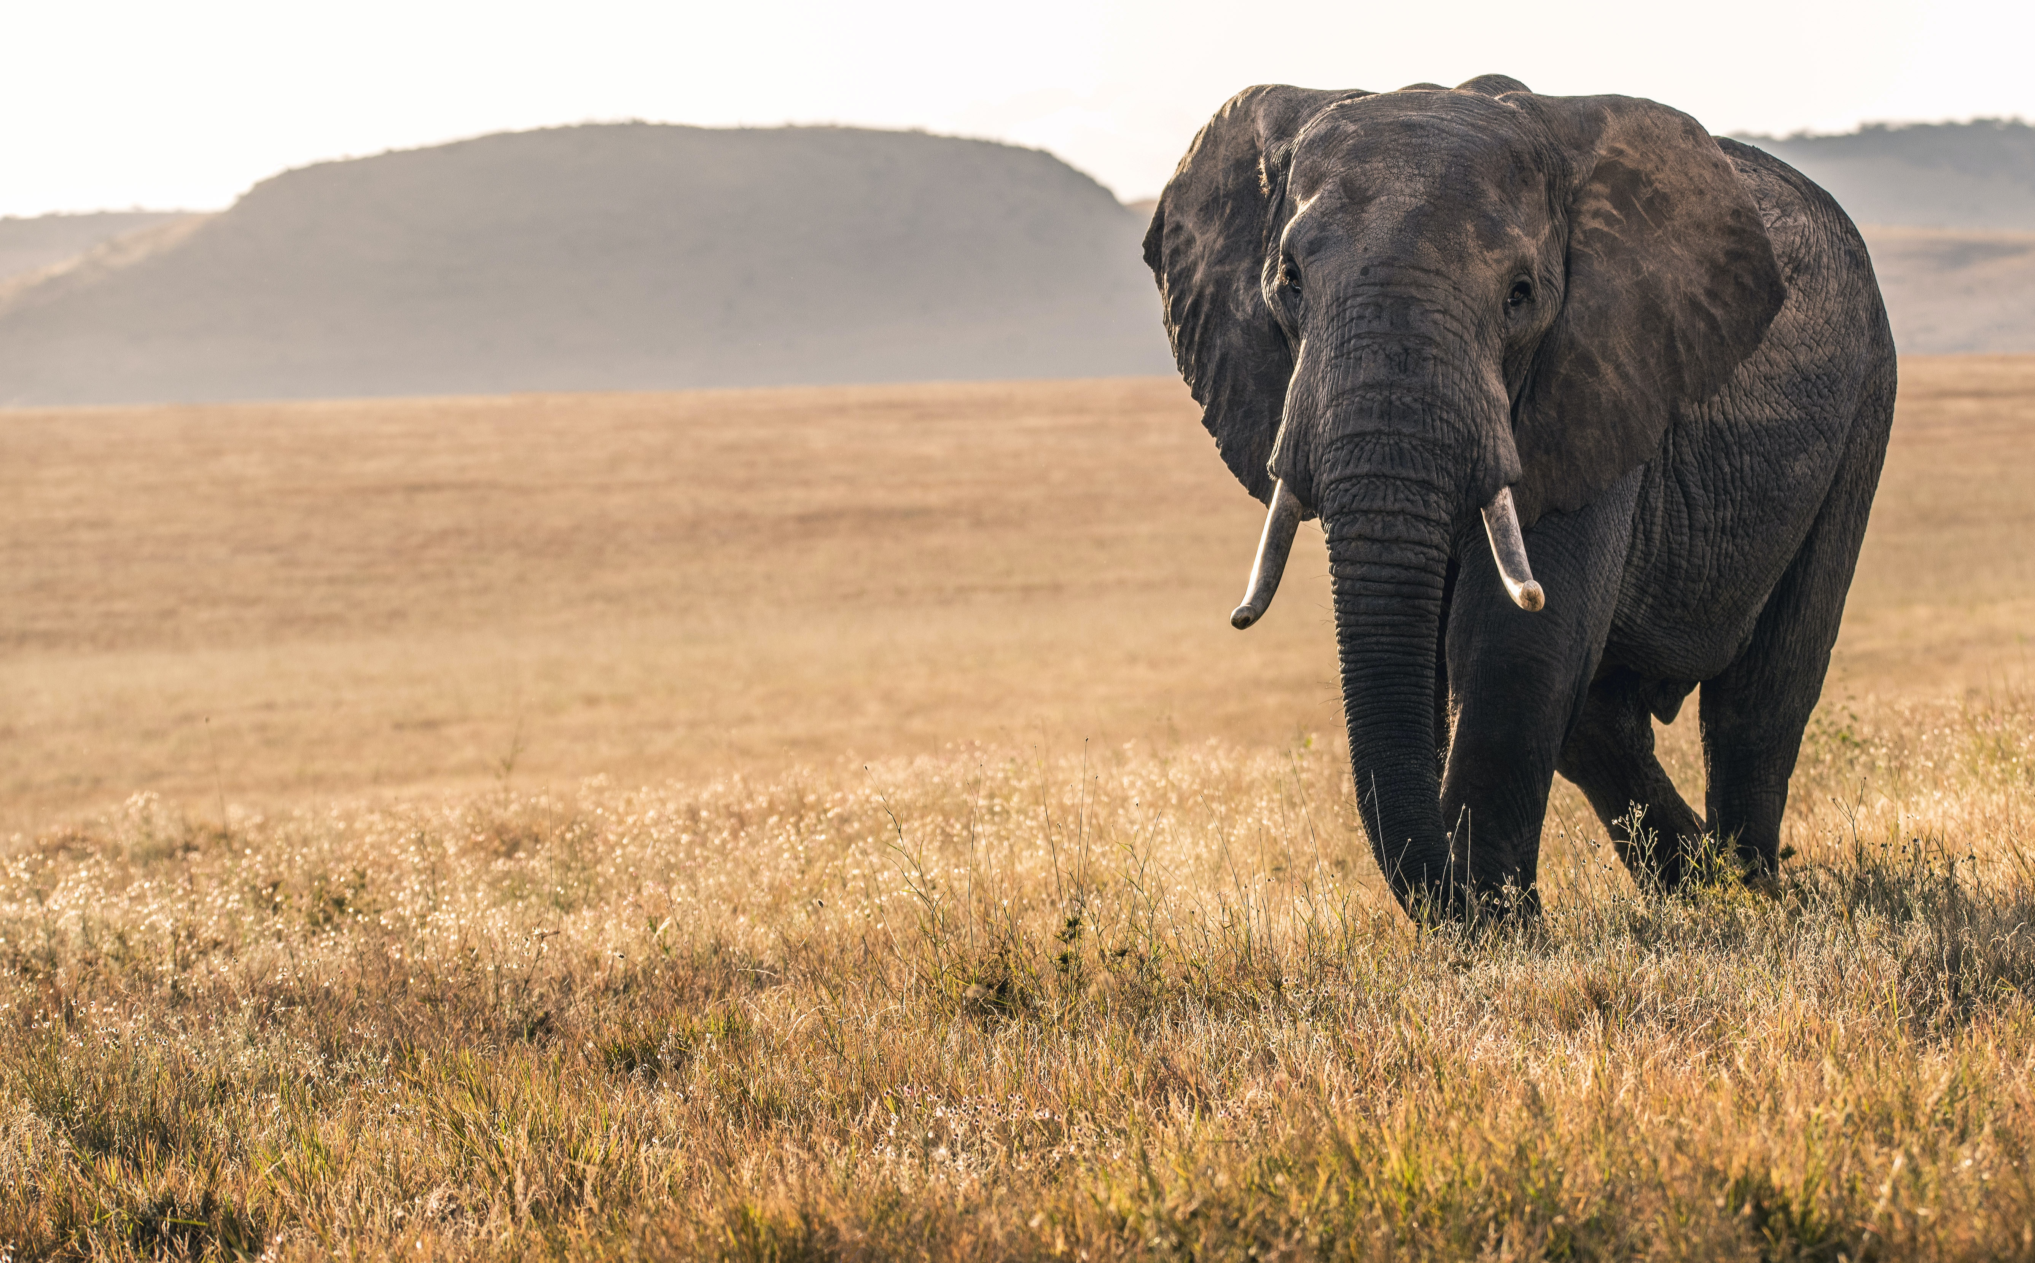

To be updated - Talia
State of Conservation Technology 2020-2022
Explore insights from our multi-year, global, community-sourced assessment of the state of the field.

Slide 3
Performance and potential of conservation technologies in 2020
Current overall performance
Capacity to advance conservation
GIS/remote sensing
1
1
AI tools
Drones
2
2
eDNA & Genomics
Mobile Apps
3
3
Networked sensors
PA mgmt. tools
4
4
PA mgmt. tools
Bioacoustics
5
5
Drones
Biologgers
6
6
GIS/remote sensing
Camera traps
7
7
Biologgers
AI tools
8
8
Bioacoustics
eDNA & Genomics
9
9
Camera traps
Data mgmt. tools
10
10
Data mgmt. tools
Networked sensors
11
11
Mobile Apps

Slide 4
Performance and potential of conservation technologies in 2022
Current overall performance
Capacity to advance conservation
GIS/remote sensing
1
1
AI tools
PA mgmt. tools
2
2
Networked sensors
Bioacoustics
3
3
Biologgers
Drones
4
4
GIS/remote sensing
Biologgers
5
5
PA mgmt. tools
Camera traps
6
6
Drones
Data mgmt. tools
7
7
Data mgmt. tools
Mobile Apps
8
8
Bioacoustics
eDNA & Genomics
9
9
Camera traps
AI tools
10
10
eDNA & Genomics
Networked sensors
11
11
Mobile Apps

Slide 5
1
Biodiversity monitoring
2
Species protection
3
Protected area mgmt. and planning
From 2020 to 2022, respondents indicated working on the same conservation issues
4
Human-wildlife conflict
5
Habitat loss or destruction
6
Public education and outreach

Slide 6
Increasing accessibility and the quickly evolving nature of the field are the main reasons for optimism for most
Opportunities, 2020
Opportunities, 2022
Increasing accessibility
Quickly evolving
Quickly evolving
Increasing accessibility
1
Collaborative culture
1
Growing support
2
2
3
3

Slide 7
1
Collaboration
2
Accessible tools
3
Interoperability of tools
Collaboration and sharing of tools are the main opportunities identified by respondents in both years
4
Data analysis scale
5
Local technology
6
Global data

Slide 8
1
Online sources
2
Individuals
3
Partners
Online sources are the main source of information for respondents, followed by individuals, partners and tech experts
4
Tech experts
5
Academia
6
Government

Slide 9
WILDLABS members were 1.5x less likely than non-members to report end-user constraints relating to accessing training or mentoring and advice.
WILDLABS members also found it easier to match technology expertise to conservation challenges, being 1.5x less likely to report this as a challenge area.
Interestingly, WILDLABS members were 2x more likely than non-members to identify scaling conservation technologies sustainbly as a primary sector-wide challenge.
WILDLABS | Membership had a measurable positive impact

Slide 10
Summary article

Slide 11
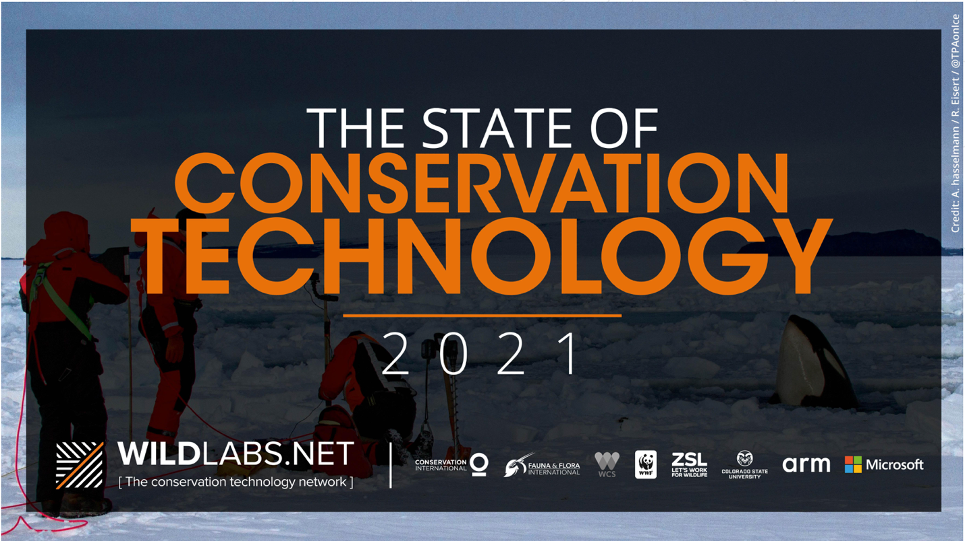
To be updated - Talia

Slide 12
Current performance of conservation technologies compared to future potential, 2020
GIS/remote sensing
1
1
AI tools
Drones
2
2
eDNA & Genomics
Mobile Apps
3
3
Networked sensors
PA mgmt. tools
4
4
PA mgmt. tools
Bioacoustics
5
5
Drones
Biologgers
6
6
GIS/remote sensing
Camera traps
7
7
Biologgers
AI tools
8
8
Bioacoustics
eDNA & Genomics
9
9
Camera traps
Data mgmt. tools
10
10
Data mgmt. tools
Networked sensors
11
11
Mobile Apps

Slide 13
Current performance of conservation technologies compared to future potential, 2022
GIS/remote sensing
1
1
AI tools
PA mgmt. tools
2
2
Networked sensors
Bioacoustics
3
3
Biologgers
Drones
4
4
GIS/remote sensing
Biologgers
5
5
PA mgmt. tools
Camera traps
6
6
Drones
Data mgmt. tools
7
7
Data mgmt. tools
Mobile Apps
8
8
Bioacoustics
eDNA & Genomics
9
9
Camera traps
AI tools
10
10
eDNA & Genomics
Networked sensors
11
11
Mobile Apps

Slide 14
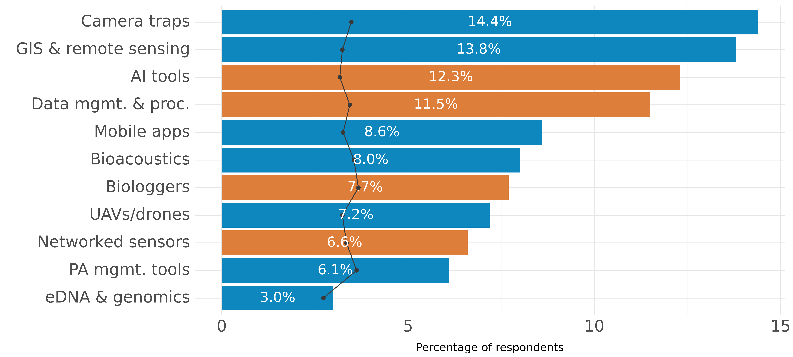
Technology in 2022 | Proficiency has been increasing in biologgers, bioacoustics and camera traps

Slide 15
1
Biodiversity monitoring
2
Species protection
3
Protected area management and planning
From 2020 to 2022, respondents indicated working on the same conservation issues
4
Human-wildlife conflict
5
Habitat loss or destruction
6
Public education and outreach

Slide 16
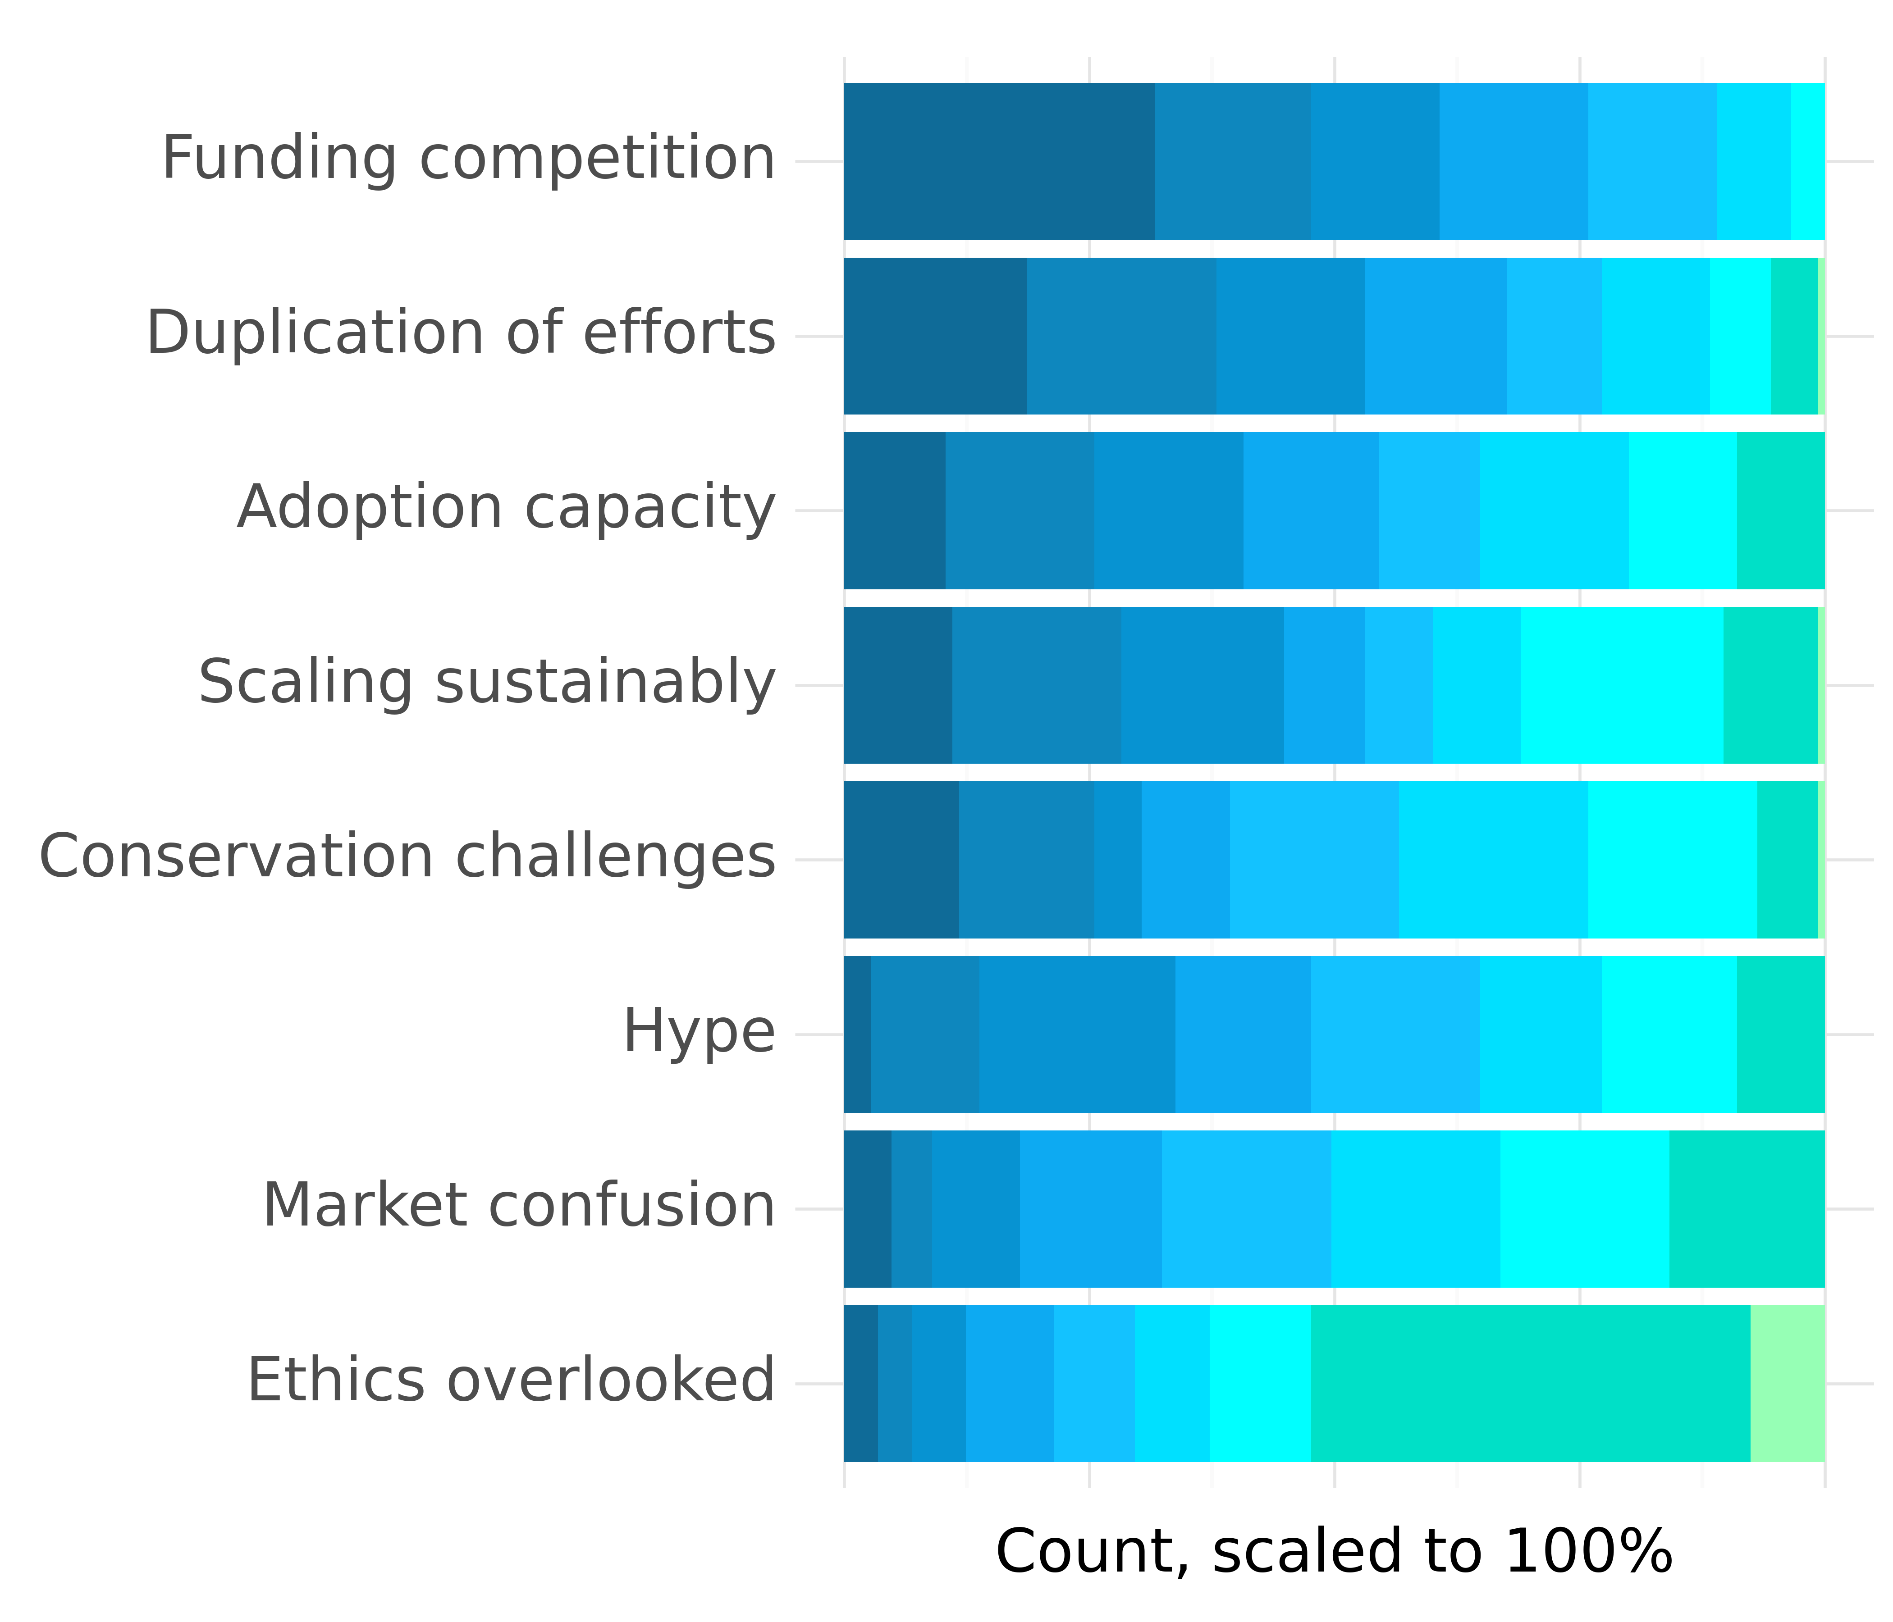
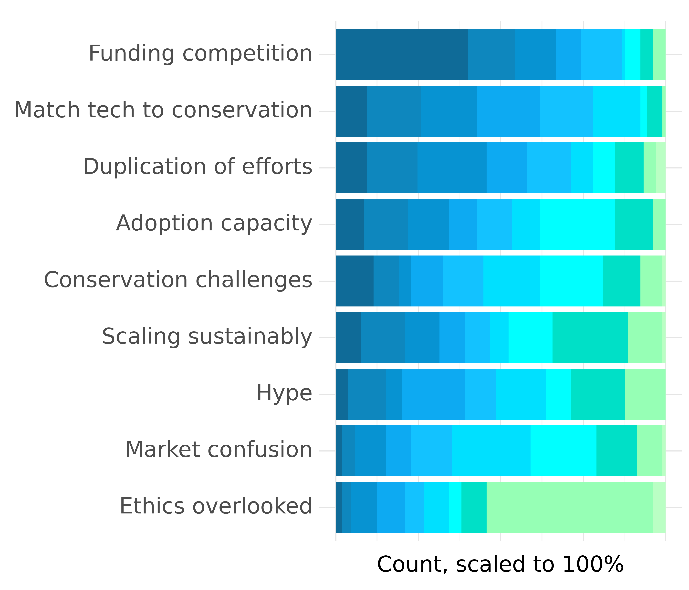
Sector-wide challenges | Funding competition is the greatest concern, followed by matching tech and conservation
Sector-wide challenges ranked in 2020
Sector-wide challenges ranked in 2022

Slide 17
End-users in developing countries were 5x as likely to report being significantly constrained by local access to technology suppliers. They were also 2.5x as likely to do so for upfront costs, as well as access to training, advice, and mentoring, and 1.5x as likely to do so for maintenance costs.
Tech developers in developing countries were 3.5x as likely to report sourcing supplies and accessing testing sites as primary constraints, and 2.5x as likely to do so for securing seed funding.
Female-identifying tech developers also reported disproportionate constraints, being 3.5x as likely to report significant constraints accessing testing sites, 2.5x as likely to do so for both securing funding throughout the development cycle and accessing relevant data, and 2x as likely to do so regarding overcoming user concerns about data security and privacy.
Challenges | Developing location and gender the most indicative contributing factor to rating

Slide 18
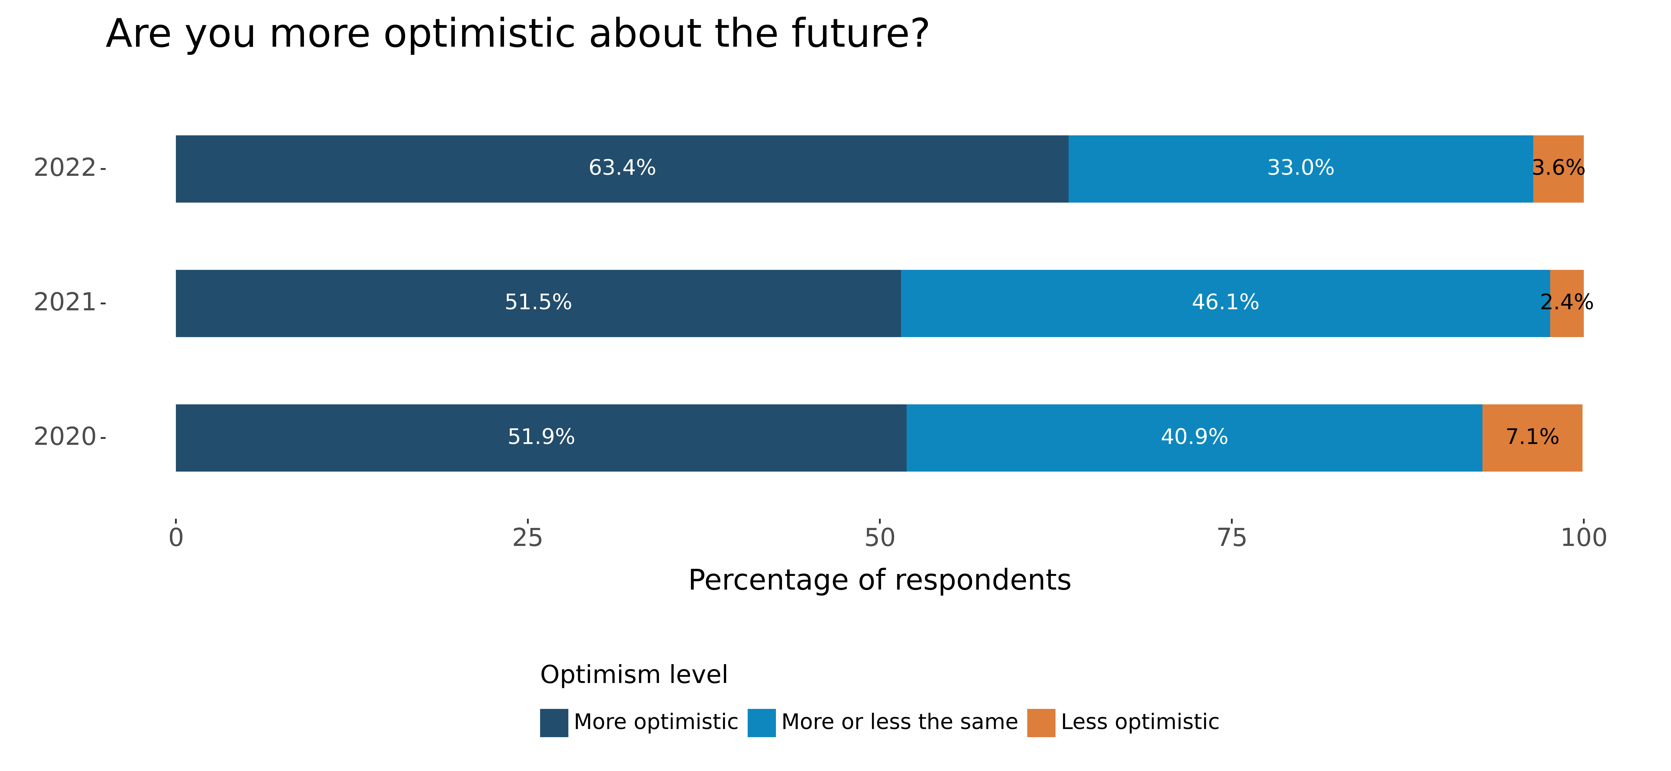
People are becoming more optimistic about the future of the conservation field over the years

Slide 19
1
Collaboration
2
Accessible tools
3
Interoperability of tools
Collaboration and sharing of tools are the main opportunities identified by respondents in both years
4
Data analysis scale
5
Local technology
6
Global data
Note: for 2021 and 2022 only

Slide 20
Increasing accessibility and the quickly evolving nature of the field are the main reason for optimism for most
Opportunities, 2020
Opportunities, 2022
Increasing accessibility
Quickly evolving
Quickly evolving
Increasing accessibility
1
Collaborative culture
1
Growing support
2
2
3
3

Slide 21
On interactions, respondents mainly commented on learning experiences and the connections they made
Learning about new technologies
Making valuable connections
Learning from each other
“
“
“
I mainly experience WILDLABS as a mental boundary extender. It's great to learn about stuff I didn't know before
Retweets from the WILDLABS account reach a varied audience and that network has proven very valuable
It is very helpful to see real-world experience and know that others are facing the same challenges
“
“
“
The use of AI on small devices that can be deployed in the field. (How cool is that?!)
Through message boards and the INCREDIBLE Stephanie, I have been connected with new collaborators who helped me create new technologies
Content sharing from Collaborators, a useful repository of conservation technology content and information
“
“
“
The tech tutor series has been incredibly useful in furthering my understanding of how to run machine learning algorithms for nature applications
The Tech Tutors meet-ups and q&a afterwards have been so incredibly helpful in building informal connections with folks I otherwise would not have known of
Hearing people's enthusiasm for what I'm doing has made me feel like I have something to offer
“
“
“
Content sharing from Collaborators, a useful repository of conservation technology content and information
A lot of issues that I previously found intimidating areas of research (like AI) seemed more approachable after hearing about other users' work
Met so many awesome collaborators and like minds; helped solve some problems (hopefully) and gotten a million (approximately) great ideas and tips

Slide 22
WILDLABS members were 1.5x less likely than non-members to report end-user constraints relating to accessing training or mentoring and advice.
WILDLABS members also found it easier to match technology expertise to conservation challenges, being 1.5x less likely to report this as a challenge area.
Interestingly, WILDLABS members were 2x more likely than non-members to identify scaling conservation technologies sustainbly as a primary sector-wide challenge.
WILDLABS membership had a measurable positive impact

